Slide 1
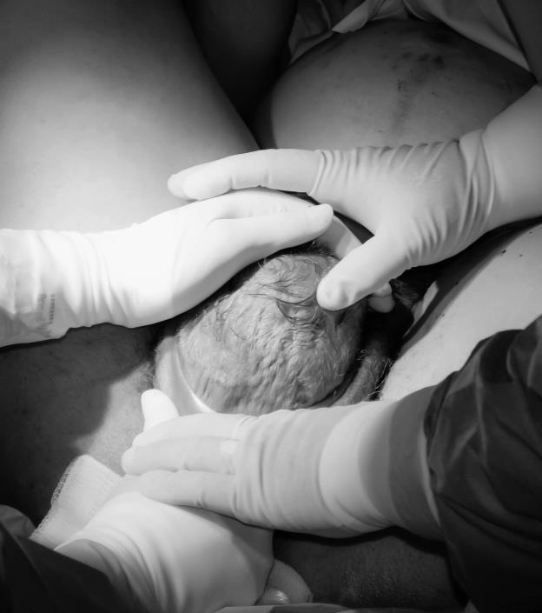
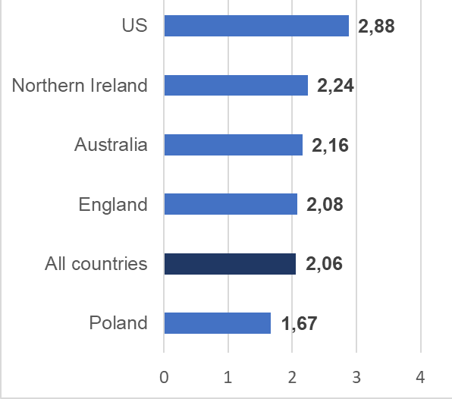
Midwifery Student Confidence for Supporting Physiologic Birth:
A 5-Country Exploration
Farley CL, Wood J, Baranowska B, Węgrzynowska M, Lazar JN, Agwu Kalu F, Davison C, Fry J, Tataj-Puzyna U, Healy M, Ritchie E, & Dole DM
Background
What shapes your confidence?
Responses & confidence level by program time point
Findings
Midwifery students need confidence in recognizing and supporting normal birth, the backbone of the midwifery professional role. Developing this confidence in the face of decreasing rates of physiologic birth worldwide
is a critical challenge. Midwife researchers from Australia, England, Northern Ireland, Poland, and the United States of America investigated midwifery student confidence for supporting normal birth and explored enhancing and detracting factors.
.
Overall confidence mean was 2.06/4.00, with Poland (1.67) as lowest confidence and the USA as highest (2.88). Factors rated most influential were the student-mentor midwife relationship (3.40) and theoretical education (3.09).
The birth environment emerged as important in the qualitative themes.
Program Entry | Intrapartum | Program Completion
“My experience, my team, my belief that the mother and baby lead the birthing experience.“ (Confident) | “I have the ability to locate evidence-based research that backs my clinical judgement; I have past experience that I can rely on to know the difference between normal and abnormal; I trust in the process of birth.” (Confident) | “I am becoming more and more able to recognize things as normal and abnormal.” (Very Confident)
“My personal experience, my knowledge of the benefits, the importance of normalizing among women.” (Fairly confident) | “Respecting patient preferences, utilizing tincture of time instead of other interventions, believing in the body's ability to birth” (Fairly confident) | “Exposure to it, Supporting women through it, Knowing it's okay” (Very Confident)
“Experience with midwife attended birth. Interdisciplinary support of midwifery model of care. Clinical experience in variety of birth settings.” (Underconfident) | “Learning it in school. Witnessing it in clinicals. Learning different techniques in order to promote normal labor and birth” (Underconfident) | Fellow midwives, nursing staff, nursing administration also supporting normality in labor and birth. Patients trusting us to support normality in labor and birth.” (Confident)
Conclusions
A mentor midwife that supports physiologic birth and is respectful of students, repeated exposure to birth environments that privilege person-centred physiologic birth, and didactic education that emphasizes the physiologic and psychologic principles that underlie midwifery care processes are crucial to ensuring midwifery students can transition to confident midwifery professionals who are advocates for physiologic birth.
A mentor guides a student’s hands on her 1st birth.
Methods
Confidence by country
A cross-sectional survey design
was undertaken with 570 midwifery students at 8 academic midwifery programmes across 5 countries.
A survey with free text and Likert-type questions on a 1 (least) to 4 (most) scale was used. The survey was distributed between 2019
and 2023. Quantitative data were analysed using descriptive statistics. Free text responses were analysed thematically.
Citation: Wood, J., Lazar, J., Baranowska, B., Davison, C., Dole, D., Farley, C. L., Fry, J., Healy, M., Agwu Kalu, F., Tataj-Puzyna, U., Ritchie, E. & Wegrzynowska, M. (2025). A five-country comparison of midwifery students' confidence in facilitating normal labor and birth. European Journal of Midwifery, 9(October), 1–12.https://doi.org/10.18332/ejm/210325

